Slide 1
Data Preprocessing

Slide 2
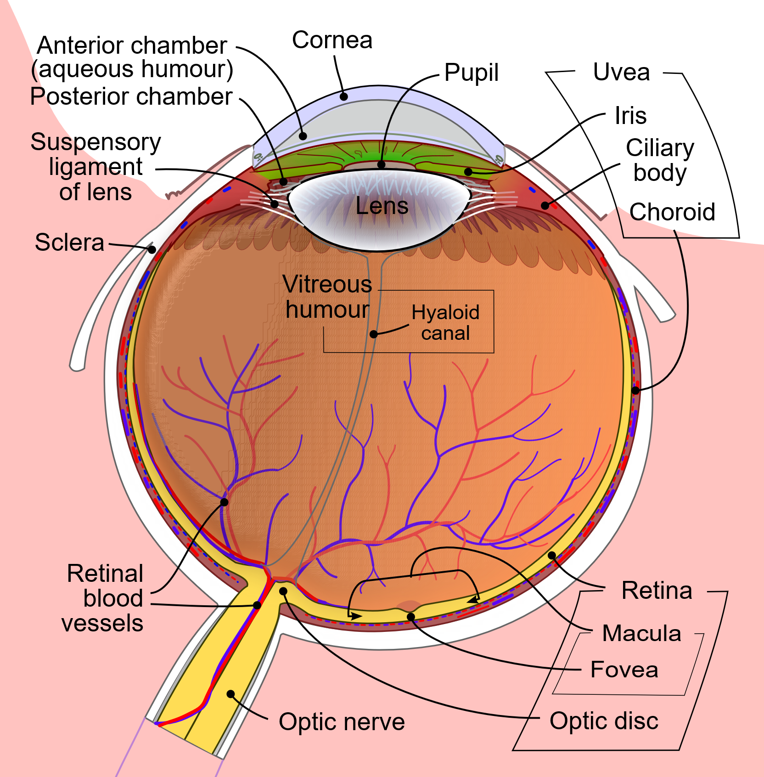
Why So Much Preprocessing?
Raw images come from different cameras, sizes, and lighting.
Preprocessing creates consistent inputs so later steps behave predictably.
Retina normalizes brightness and emphasizes contrast before the cortex “reads” the scene.
By Rhcastilhos. And Jmarchn. - Schematic_diagram_of_the_human_eye_with_English_annotations.svg, CC BY-SA 3.0, https://commons.wikimedia.org/w/index.php?curid=1597930

Slide 3
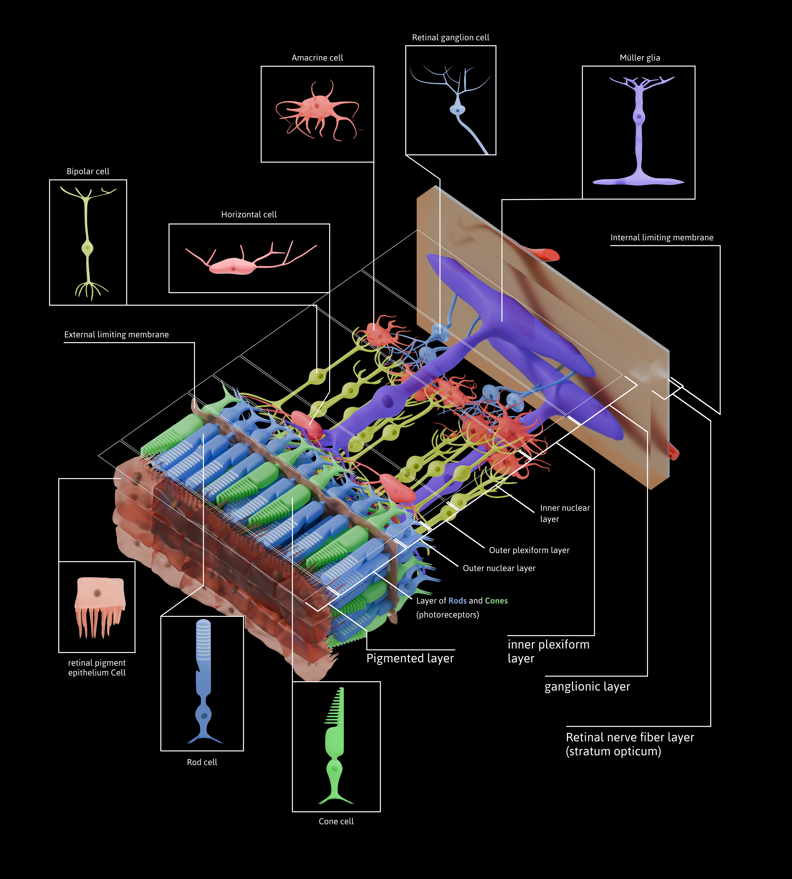
Pipeline Overview
[ Image placeholder: Center–surround kernel sketch + rod/cone distribution across retina ]
Ingest & inspect
Split
Geometry
Color management
Intensity scaling
Save
By Otosakanum2 - Own work, CC BY-SA 4.0, https://commons.wikimedia.org/w/index.php?curid=174602486
Notes:
Just like our eyes go through lots of steps before sending information to our brain, we have to prepare our data for modeling

Slide 4
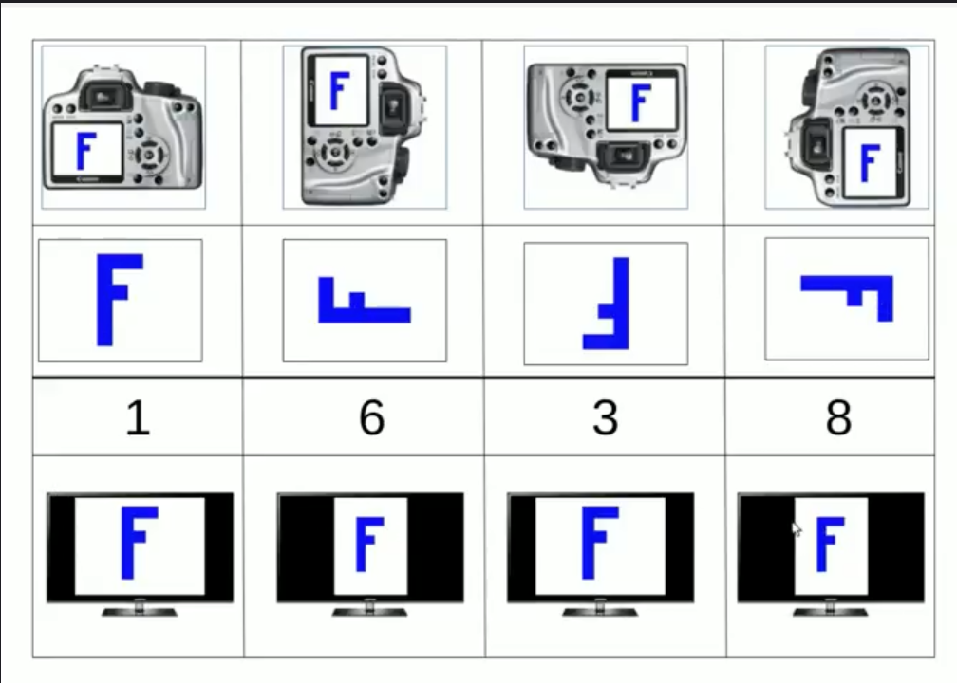
Ingest & Inspect
Check orientation: Make sure “sideways” phone photos aren’t silently wrong.
Quick EDA: Find outliers (pure black/white, corrupt images).
Remove duplicates: if the dataset was scraped—near-duplicate images bias results.
Notes:
The image on the right shows how the EXIF image codes tell you how to orient the image correctly.

Slide 5
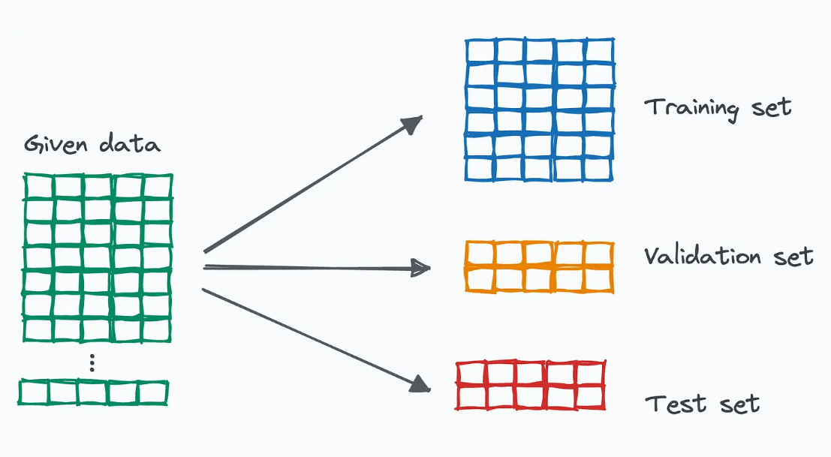
Train-Validation-Test Split
Split the data and compute calculations based only on the training set

Slide 6
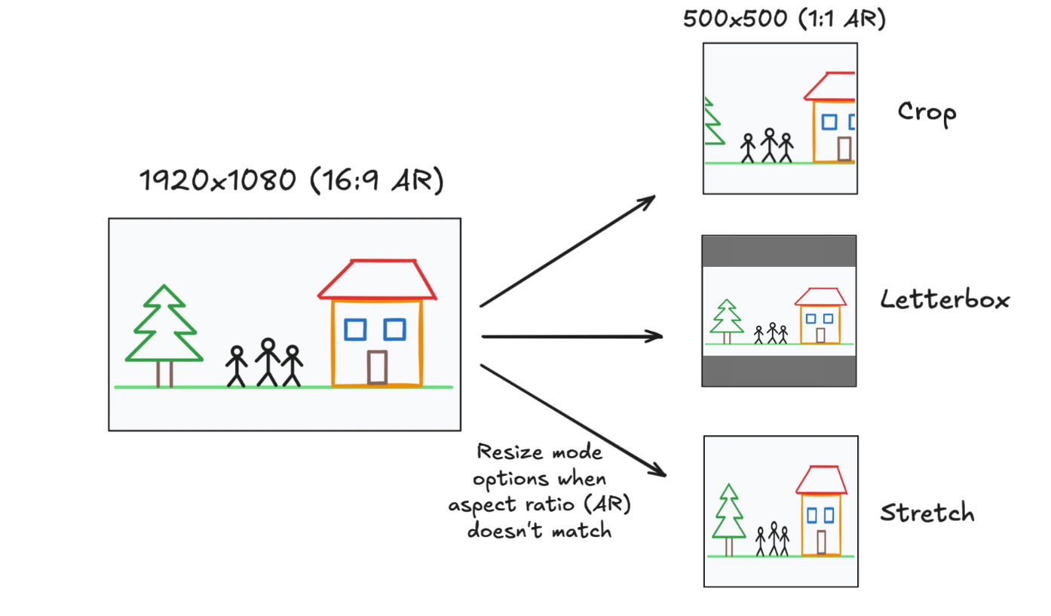
Geometry
Make every image the same size
There are multiple ways to do this with pros and cons to each

Slide 7
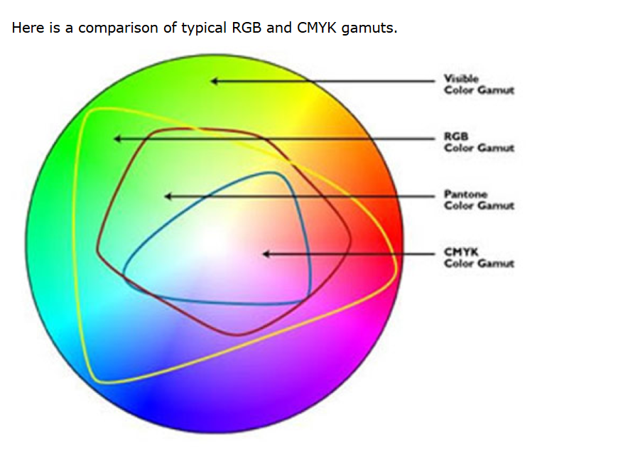
Color vs Grayscale
Convert to grayscale if color isn’t informative
Choose an RGB workspace so numbers look the same across the dataset.
(R,G,B) = (120, 180, 240) always means the same color no matter which camera or app produced the file.

Slide 8

Intensity Scaling
Put pixel values into a 0 – 1 range so math is stable and comparable.
Sufficient for edge/corner/blob detection,
8-bit images divide by 255.0
16-bit images: divide by 65535.0
Ex 8-bit image
RGB(243, 100, 2) = RGB(0.953, 0.392, 0.008)

Slide 9
Intensity Scaling
Standardize based on training data values
Necessary for machine learning modeling
Compute one mean and one std per color channel across all pixels of all images in the training set.
Compares the R, G and B values for that image to the other images in the dataset
R: µ = 0.90, σ = 0.16
G: µ = 0.45, σ = 0.10
B: µ = 0.055, σ = 0.07
RGB(0.953, 0.392, 0.008) = RGB(0.33, -0.58, 0.85)
R: (0.953 - 0.90)/ 0.16 = 0.33
G: (0.392 - 0.45)/ 0.10 = -0.58
B: (0.055 - 0.008)/ 0.055 = 0.85

Slide 10
Save and Document
Save the processed images or save a script/config that can regenerate them on demand.
Record the exact steps and parameters
Fix random seeds. Keep version numbers of libraries.

Slide 11
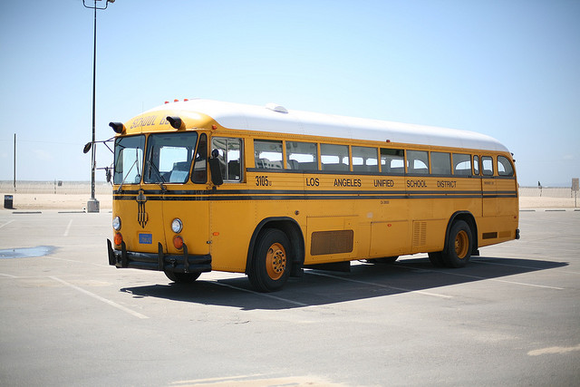
COCO Dataset
COCO (Common Objects in Context) is a large-scale dataset for object detection hosted at cocodataset.org. COCO Dataset
Designed to capture everyday scenes “in context,” not just centered objects.
Introduced in 2014 by Lin et al. (“Microsoft COCO: Common Objects in Context”)

Slide 12

Python Pillow Library
PIL (Python Imaging Library) was created by Fredrik Lundh and Secret Labs AB, first released 1995. Development of PIL effectively stopped around 2011.
Pillow is the actively maintained, “friendly PIL fork,” started in 2010 by Jeffrey “Alex” Clark with community contributors; it added Python 3 support and ongoing releases.

Slide 13
Python Pillow Library
Open/save many formats (JPEG, PNG, TIFF, WebP, etc.).
EXIF support (read metadata, auto-rotate via Orientation).
Resizing, cropping, rotate/transpose; affine & perspective transforms.
Color modes & conversion (RGB/RGBA/CMYK/L/P) + ICC/Color management
Filters & enhancements (blur/sharpen; brightness/contrast/color/sharpness).
Draw text/shapes (ImageDraw, ImageFont).

Slide 14
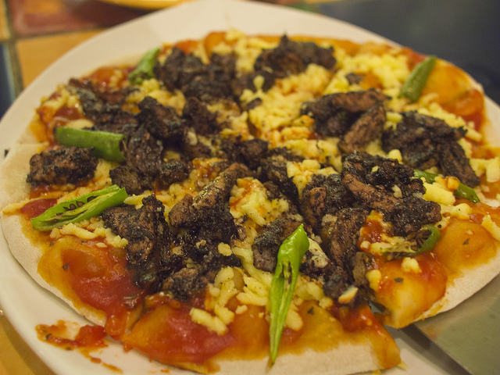
Let’s Do It!

